Slide 1

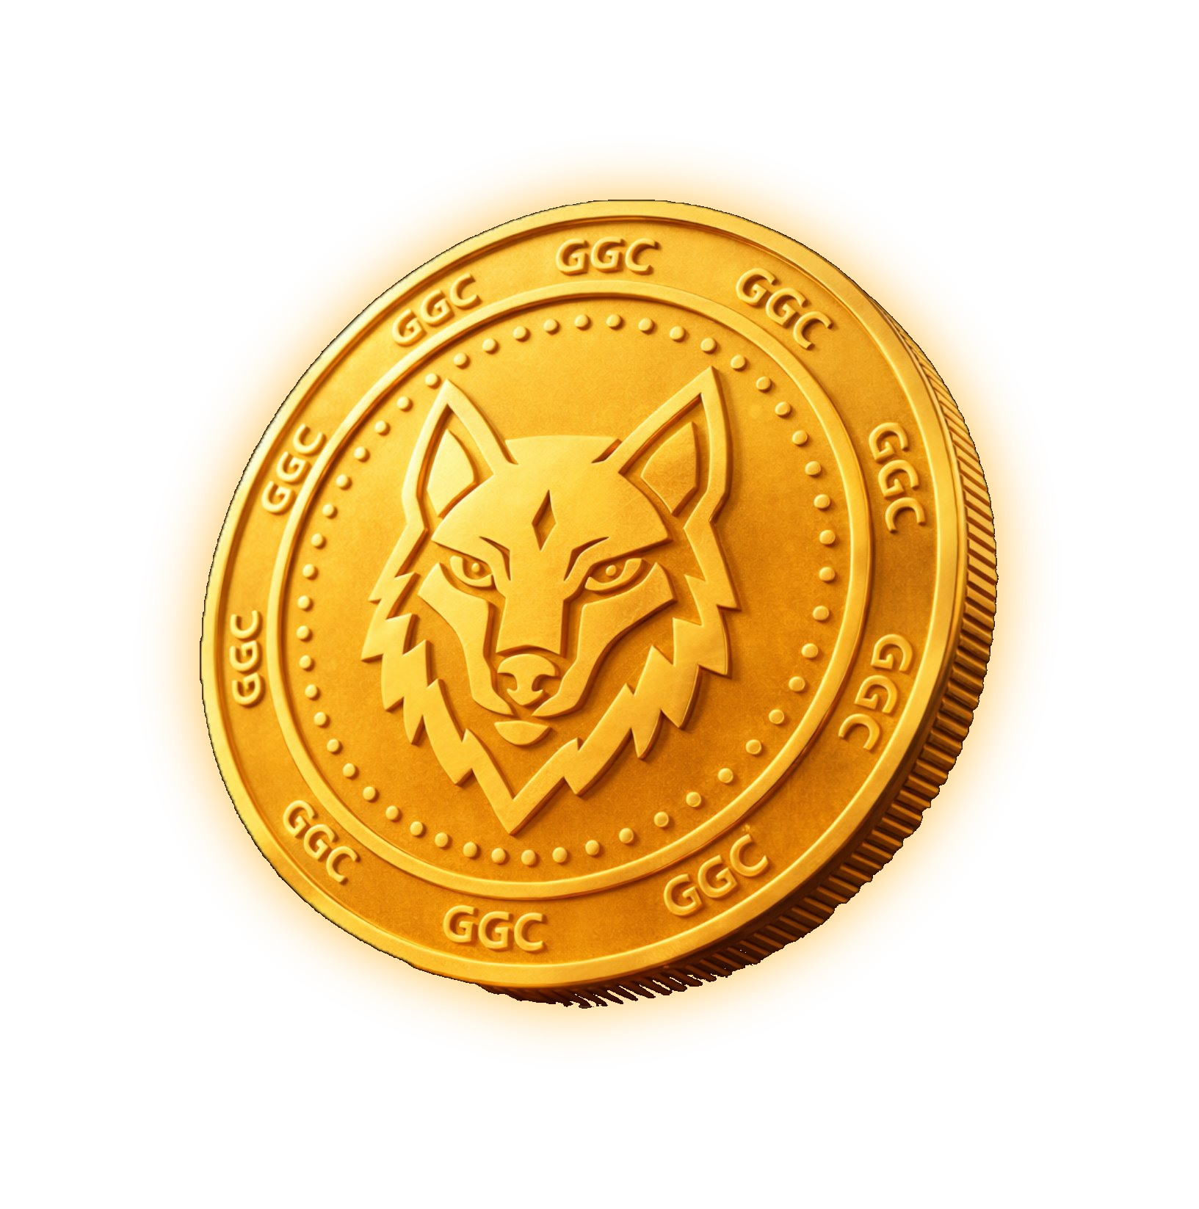
MAXIMIZE YOUR DIGITAL WEALTH
GAME GEM
COIN
TAP · STACK · EARN
Mining, team building, and staking — one complete ecosystem.
6-Hour Mining
7-Level MLM
Daily Staking
GAME GEM COIN
01 / 13

Slide 2






01 / INTRODUCTION
WHAT IS GGC MINING?
THE MULTI-WALLET SYSTEM
An advanced digital application to mine Game Gem Coin (GGC) while unlocking multiple fiat-equivalent earning streams — built for a sustainable, gamified economy.
Main Wallet
Commission
USDT
USDT
Interconnected & swappable
Interconnected & swappable
CORE GOAL
Leader Wallet
GGC Token
Reward active participation, team expansion, and long-term token staking — all in one app.
USDT
Native
Interconnected & swappable
Built for modern mobile · deep-link sharing for instant network growth
GAME GEM COIN
02 / 13

Slide 3



02 / CORE MINING MECHANICS
THE 6-HOUR MINING CYCLE
6 HRS
80
320
Continuous mining cycle
GGC per cycle (standard)
GGC with 2+ referrals
EXCLUSIVE AUTO-BOT
$1 / 21 days
Tired of manual tapping? Automatically restart every mining cycle.
GAME GEM COIN
03 / 13

Slide 4

03 / PREMIUM MINING BOOSTERS
AMPLIFY YOUR 6-HOUR YIELD
Starter
$3
880
Base
Tycoon
$50
19,999
+2,173%
Master
$5
1,600
+82%
Neso
$100
41,076
+4,568%
Leader
$10
3,333
+279%
Proteus
$250
111,111
+12,526%
Conqueror
$30
11,111
+1,163%
Triton
$500
222,222
+25,152%
Every Booster Ensures Value Stability and Scalability
GAME GEM COIN
All boosters run on 21-day cycles · bars scaled to relative yield
04 / 13

Slide 5

04 / 7-LEVEL AFFILIATE PROGRAM
EARN 30% ACROSS 7 LEVELS
Massive commission distributed on every purchase & renewal in your network.
Level 1 — Directs
10%
Level 2
8%
Level 3
5%
Level 4
3%
MINING BONUS +1% GGC
Level 5
2%
Direct sponsors earn 1% GGC from Level-1 mining activity.
Level 6
1%
30%
TOTAL
Level 7
1%
GAME GEM COIN
05 / 13

Slide 6




05 / COMPLETE RANK ACHIEVEMENTS
CLIMB RANKS · EARN USDT
RANK
TEAM
DIR.
BUSINESS
REWARD
ELITE TIERS
0. Bronze
15
5
$9
—
1. Novice
50
5
$25
$3
2. Miner
80
8
$40
$5
3. Diamond
100
10
$100
$10
Wolf
Master
4. Elite
120
10
$300
$30
5. Legendary
150
15
$450
$50
6. Master
200
20
$600
$80
7. Wolf
250
25
$750
$150
Crypto King
Conqueror
8. Crypto King
350
30
$900
$200
9. Conqueror
500
50
$1,500
$300
GAME GEM COIN
Legendary 6 and above require specific sub-ranks held by downline members.
06 / 13

Slide 7


06 / GGC STAKING — RSMW
PASSIVE DAILY INCOME
The Revenue Share Modal Wallet (RSMW) pays daily USDT simply for staking your GGC — reducing circulating supply for price stability.
450
Earn
$
Days locking period
Daily reward on stacked value
TIERED STAKING SLABS
S1
S2
S3
2M – 9.9M
10M – 19.9M
20M+
GAME GEM COIN
07 / 13

Slide 8








07 / GAMIFICATION & XP SYSTEM
PLAY MORE · EARN MORE
EARN XP FOR EVERYDAY ACTIONS
MILESTONE REWARDS
Daily Login
+5 XP
LEVEL 21
Free 7-day trial of the Exclusive Auto-Bot.
Chat Streaks
up to +300 XP
Direct Referral
+150 XP
LEVEL 100
Lifetime Exclusive Bot + a FREE Conqueror Booster.
Level-Up Discounts
up to 15% off
Tier progression
GAME GEM COIN
08 / 13

Slide 9




08 / WITHDRAWALS & SECURITY
SECURE, FLEXIBLE PAYOUTS
Withdraw your USDT earnings directly to your external crypto wallets — fast, safe, and protected.
TRC20
BEP20
Admin Approval
Every withdrawal verified — auto-refund on rejection
Tron Network
BNB Smart Chain
KYC Compliance
In-app KYC gate ensures regulatory readiness
Low fees · fast settlement
Wide exchange support
Withdrawals processed safely to external TRC20 / BEP20 addresses, guarded by an admin approval protocol with automatic refunds for rejected requests.
GAME GEM COIN
09 / 13

Slide 10




09 / TOKENOMICS & LIQUIDITY
HOW BOOSTER FUNDS WORK
Every booster purchase is strategically allocated to ensure ecosystem longevity and a stable listing price.
Liquidity Pool
30%
THE POWER OF THE POOL
Reward Sharing (MLM & Ranks)
30%
More boosters → deeper liquidity → a stable listing price. Bulk-mine now to maximize wealth at listing.
RSMW Staking Payouts
20%
Project Scaling & Development
20%
LISTING STRATEGY
GGC lists on public exchanges once user-acquisition and mining milestones are met.
GAME GEM COIN
10 / 13

Slide 11


10 / ECOSYSTEM EXPANSION
COMING SOON
Massive new utility & burn mechanics on the horizon.
GGC Wallet
GGC GameHub
A dedicated in-app Web3 wallet to seamlessly swap mined GGC directly for USDT.
A Play-to-Earn & Play-to-Consume gaming ecosystem — spend GGC to play, or play to earn more.
Instant swaps
Self-custody
Secure
Play-to-Earn
Token burn
More utility
GAME GEM COIN
11 / 13

Slide 12


11 / CONCLUSION
BUILD YOUR MINING EMPIRE
A complete economy — tapping, staking & team building
A sustainable liquidity model for a stable listing
Deep 7-level commissions + high-yield rank bonuses
Automated mining bots & up to 15% level discounts
CREATE ACCOUNT · START MINING
GAME GEM COIN
12 / 13

Slide 13
THANK YOU
for reading the Game Gem Coin proposal
gamegemcoin.co.uk
Contact the person who shared this with you
GAME GEM COIN
13 / 13

